Slide 1









Coverage Autumn 1 2024
Week | News Story | Focus Question | British Value Link | Protected Characteristics | UN Article
26th August | A nine-year-old girl is set to make history as the youngest person ever to represent the UK internationally in any sport. Bodhana Sivanandan, from Harrow, northwest London, has been selected for the team representing England at the Chess Olympiad in Budapest in September. | Should your age ever stop you from doing something? | Democracy | Age
2nd September | Over the summer, many protests took place in England and Northern Ireland. Following the protests, communities in many towns, including Middlesborough, organised clean-up efforts that united people from all faiths and races. | How can communities help each other in times of difficulty? | Mutual Respect and Tolerance | Race
9th September | Space agency, Nasa, says two astronauts stuck on the International Space Station (ISS) won't return to Earth until next year. Sunita Williams and Barry 'Butch' Wilmore originally went on an eight-day mission but so far have remained for two months. | How can we respond to unexpected events? | Individual Liberty | Religion or Belief
16th September | The Wildlife Photographer of the Year shortlist has recently been announced, with just 100 photos left in the competition, following a record-breaking 59,228 entries! | How can photos shape the world? | Mutual Respect and Tolerance | Age
23rd September | The UK's first teacherless classroom, using AI (artificial intelligence) instead of human teachers has opened. David Game College, a school in London, opened its new course for twenty GCSE pupils in September. | Will classrooms of the future be teacherless? | Rule of Law | Religion or Belief
30th September | Book publishing company, Penguin Random House UK, has revealed a new book-vending machine at Linlithgow Academy, near Edinburgh, Scotland. The machine gives the pupils access to more than seventy different books from Penguin’s ‘Lit in Colour’ reading lists. | How important is it to know about the author behind the book? | Mutual Respect and Tolerance | Race
7th October | The company, Amazon, has told all staff they need to return to the office five days a week, ending the option to work from home. | How important are human interactions? | Individual Liberty | All
14th October | UK Prime Minister, Sir Keir Starmer, has faced questioning and criticism recently for accepting free gifts. | Why do people give gifts? | Rule of Law | Race
21st October | Following a ten-year campaign, music exam boards have announced they will now be including Sikh sacred music, also known as Kirtan, on their syllabus. | What impact can music have on our lives? | Democracy | Religion or Belief
© Picture News 2024

Slide 2



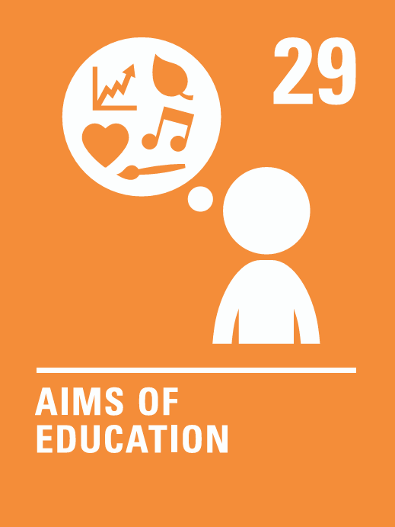



Coverage Autumn 2 2024
Week | News Story | Focus Question | British Value Link | Protected Characteristics | UN Article
28th October | People in the USA will head to the polls on Tuesday 5th November to elect the next US president. The winner will serve a term of four years in the White House, starting in January 2025. | What are the qualities that make a good leader? | Democracy | Sex
4th November | A 23-year-old British climber has become the youngest woman to summit the world's fourteen highest mountains. Adriana Brownlee reached the 8,027m peak of Shishapangma in Tibet, at around 8am on 9th October. | How can our hopes and dreams help us to succeed? | Individual Liberty | Age
11th November | This year, Anti-Bullying Week takes place on 11th-15th November with the theme, ‘Choose Respect’. As part of the week, Odd Socks Day is on Tuesday 12th November, with odd socks being worn to celebrate what makes us all unique. | What impact can bullying have on a community? | Mutual Respect and Tolerance | All
18th November | A discovery of more than 6,000 ancient Maya structures, including a city of pyramids, has been named Valeriana. Hidden by jungle canopy in the Mexican state of Campeche, the city was discovered by chance. | Why is discovery important? | Mutual Respect and Tolerance | Race
25th November | This year’s Earthshot Prize winners have been announced. Prince William, who launched the prize in 2020, closed the award ceremony in Cape Town, South Africa. The Earthshot Prize celebrates and supports people and companies working to provide innovative solutions for climate and environmental issues.. | How can we raise awareness of important issues? | Democracy | Religion or Belief
2nd December | The Football Association (FA) has laid out new plans aimed at raising awareness and increasing participation in disability football. | What does it mean to feel included? | Individual Liberty | Disability
9th December | Wicked, the hugely successful Broadway musical, has recently premiered worldwide as a film. | Should everyone have the opportunity to be a star? | Individual Liberty | Age
16th December | It is thought the number of cards sent this festive period will be lower than in previous years, as stamp prices have increased. | How can we show others we care? | Rule of Law | Religion or Belief
© Picture News 2024

Slide 3
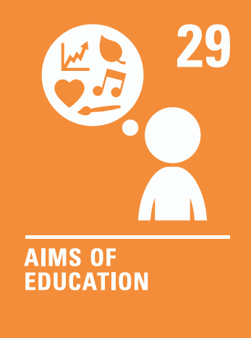


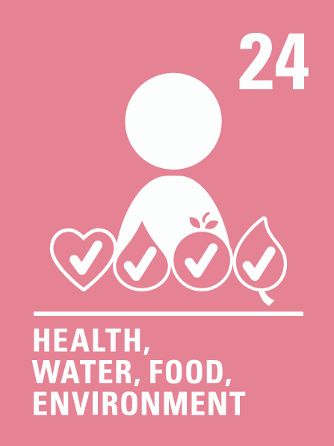


Coverage Spring 1 2025
Week | News Story | Focus Question | British Value Link | Protected Characteristics | UN Article
6th January | Birdwatch 2025 is an annual UK-wide citizen science project, held in January, in which people help gather data to support the work of scientists. | Is it our responsibility to protect local wildlife? | Rule of Law | Race
13th January | Prime Minister Keir Starmer has stated that building new homes is a 'top priority.' The government has announced changes to planning rules, aiming to make it easier to build homes in the countryside. | Should you be allowed to build homes anywhere? | Democracy | Age
20th January | The UK government’s culture secretary, Lisa Nandy, has written to video-sharing platforms, such as YouTube and TikTok, asking them to actively share more educational content for children. | Should YouTube have more rules for younger users? | Rule of Law | Age
27th January | New data has shown that 2024 was the Earth's hottest year on record, warming by 1.5°C. | Who should be involved in key decisions for the world? | Democracy | Race
3rd February | Tennis player Emma Raducanu has revealed that she would like to meet darts champion Luke Littler after stating her respect for his recent achievement in becoming a world darts champion. | Do you need to feel under pressure to achieve great things? | Individual Liberty | Age
10th February | The Nepalese government has announced that, from September, climbers aiming for the world’s highest mountain will have to pay just over £12,000 ($15,000) during the main climbing season | Should we be allowed to travel anywhere we like? | Mutual Respect & Tolerance | Religion or Belief
17th February | Global retail giant, Amazon, has announced its first UK drone deliveries will take place in Darlington as part of a trial. | Are drones the future of delivery? | Democracy | All
© Picture News 2025

Slide 4



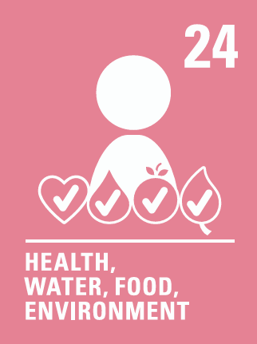



Coverage Spring 2 2025
Week | News Story | Focus Question | British Value Link | Protected Characteristics | UN Article
24th February | A girls’ football team, in York, has launched a campaign called 'Girls can have short hair – get over it'. | Why do we judge people based on their appearance? | Mutual Respect and Tolerance | Sex
3rd March | The Times newspaper recently asked young people aged between 18 and 27 (also known as ‘Gen Z’) what they thought about their lives and life in the UK. | Is it important to feel proud of where you come from? | Mutual Respect and Tolerance | Race
10th March | The Princess of Wales has recently shared pictures drawn by herself, Prince George, Princess Charlotte, and Prince Louis of each other. | How can we make connections with others? | Individual Liberty | Religion or Belief
17th March | 750 schools in England have been chosen to trial free daily breakfast clubs, to see whether they could work for all schools. | Is it important to have a morning routine? | Rule of Law | Age
24th March | World leaders from around twenty countries are creating a group or ‘coalition’. According to UK Prime Minister, Starmer, they will work together to support Ukraine. | Do world leaders have a duty to help other countries? | Democracy | Race
31st March | English football team, Manchester United, have announced plans to build the biggest stadium in the UK. | Should stadiums be used for more than just football? | Democracy | Sex
7th April | Ex-England football manager, Sir Gareth Southgate, says he fears young people are spending too much time gaming and online, and that they need better role models beyond social media influencers. | What qualities should a positive role model have? | Individual Liberty | Age
© Picture News 2025

Slide 5

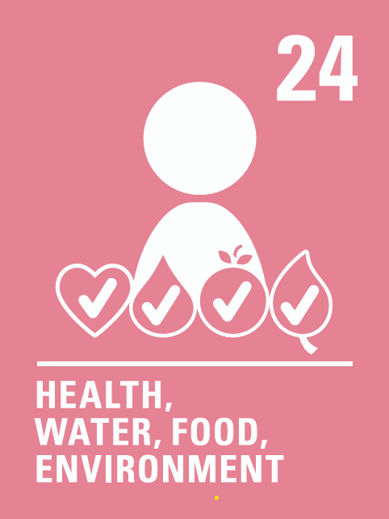



Coverage Summer 1 2025
Week | News Story | Focus Question | British Value Link | Protected Characteristics | UN Article
21st April | Singer, Ed Sheeran, has written a letter to UK Prime Minister, Sir Keir Starmer, asking for more money to support music education in schools. | Should music be part of every school day? | Democracy | Disability
28th April | Workers in Birmingham have been on strike (choosing not to work) since January because they don’t think the way they are being treated, or their pay, is fair. | Whose job is it to keep our local places clean and tidy? | Mutual Respect | Sex
5th May | The government has recently announced that a new theme park will be built in the UK, which is due to open in 2031. | What makes somewhere special to visit? | Individual Liberty | Disability
12th May | Three teenagers from Indore, India — Dhruv Chaudhary, Mithran Ladhania, and Mridul Jain have created a salt-powered fridge. | What everyday items could be changed to help others? | Mutual Respect and Tolerance | Age
19th May | A vehicle once used by Pope Francis to wave and greet people—called a popemobile—is being turned into a mobile health clinic for children in Gaza. | Can donating something important be a powerful way to show you care? | Individual Liberty | Religion or Belief
© Picture News 2025

Slide 6








Coverage Summer 2 2025
Week | News Story | Focus Question | British Value Link | Protected Characteristics | UN Article
26th May | The UK government has launched an online exhibition to show five different designs for a new national memorial for Queen Elizabeth II. | What are some special or meaningful ways to remember someone? | Democracy | Religion or Belief
2nd June | The UK has a new astronaut currently training with NASA in the United States of America (USA) for the next six months. | How does it feel to be the first to do something? | Individual Liberty | Sex
9th June | Zoos, aquariums and safari parks in Great Britain will soon have to follow new rules to help them take better care of animals. | What do animals need to be happy and healthy in zoos? | Rule of Law | Disability
16th June | Big Ocean is a new K-pop band from South Korea, and all three of its members have hearing loss. | What can we learn from people who communicate in different ways? | Mutual Respect and Tolerance | Disability
23rd June | Nearly 140 years after it sank, a team of divers has discovered the wreck of a ship called the SS Nantes off the coast of Devon, in southwest England. | Why do people explore the past? | Individual Liberty | Race
30th June | Taxi company, Uber, wants to test cars in London that can drive by themselves, without a person at the wheel. | Are driverless taxis a good idea? | Democracy | Disability
7th July | Scientists in Australia have discovered that some of the country’s first human beings lived in high mountain caves about 20,000 years ago. | What makes somewhere a good place to live? | Mutual Respect and Tolerance | Race
14th July | Yuliia Brykailo, a Ukrainian mother who moved to the Isle of Man after fleeing the war, has written a children’s book inspired by her daughter Veronika’s experience of settling into a new school. | How can stories help us understand others? | Mutual Respect and Tolerance | Race
© Picture News 2025

